Slide 1
Face Emotion Recommendation Detection System - FERDS
Agastyn Jay Manivannan’s

Slide 2


Agenda
A
Introduction
Internship Journey
My App
Demo Video
Toolkit Walkthrough
Thank you/My Contacts

Slide 3
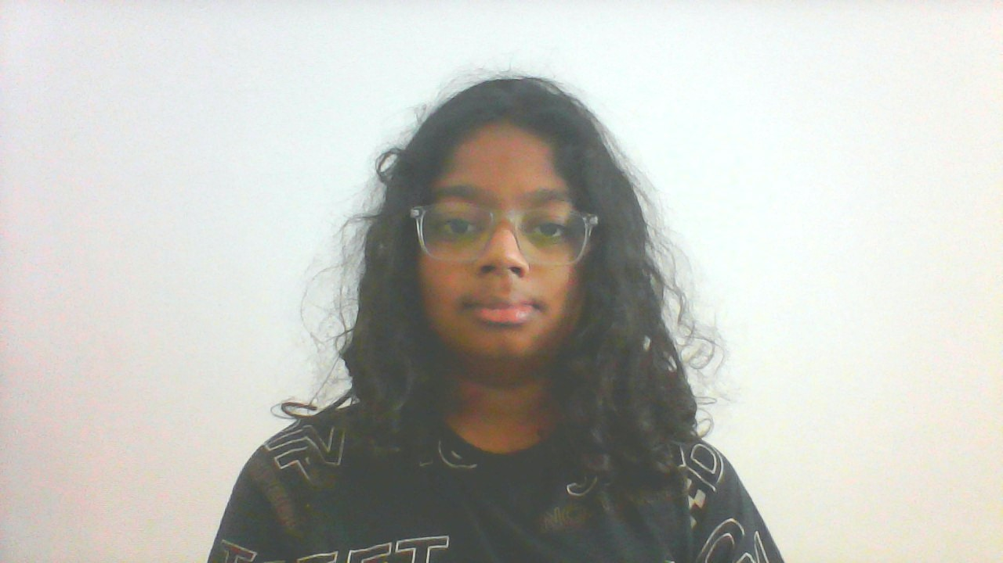
Introduction
Hi, I am Agastyn. I am 11 years old and I am from India, but live in Dubai. I started my journey as a coder in the start of 2020

Slide 4
Internship journey
I
My internship journey so far was amazing. The teachers where giving feedback about my work and responding very quickly when I had a doubt

Slide 5
About App/Usage of the App
My app is a Face Emotion Recommendation Detection System (FERDS) that starts with a introduction page (made by Tk), then moves on to the live video feed (camera) then goes to the recommendation if you where happy, sad, etc..

Slide 6
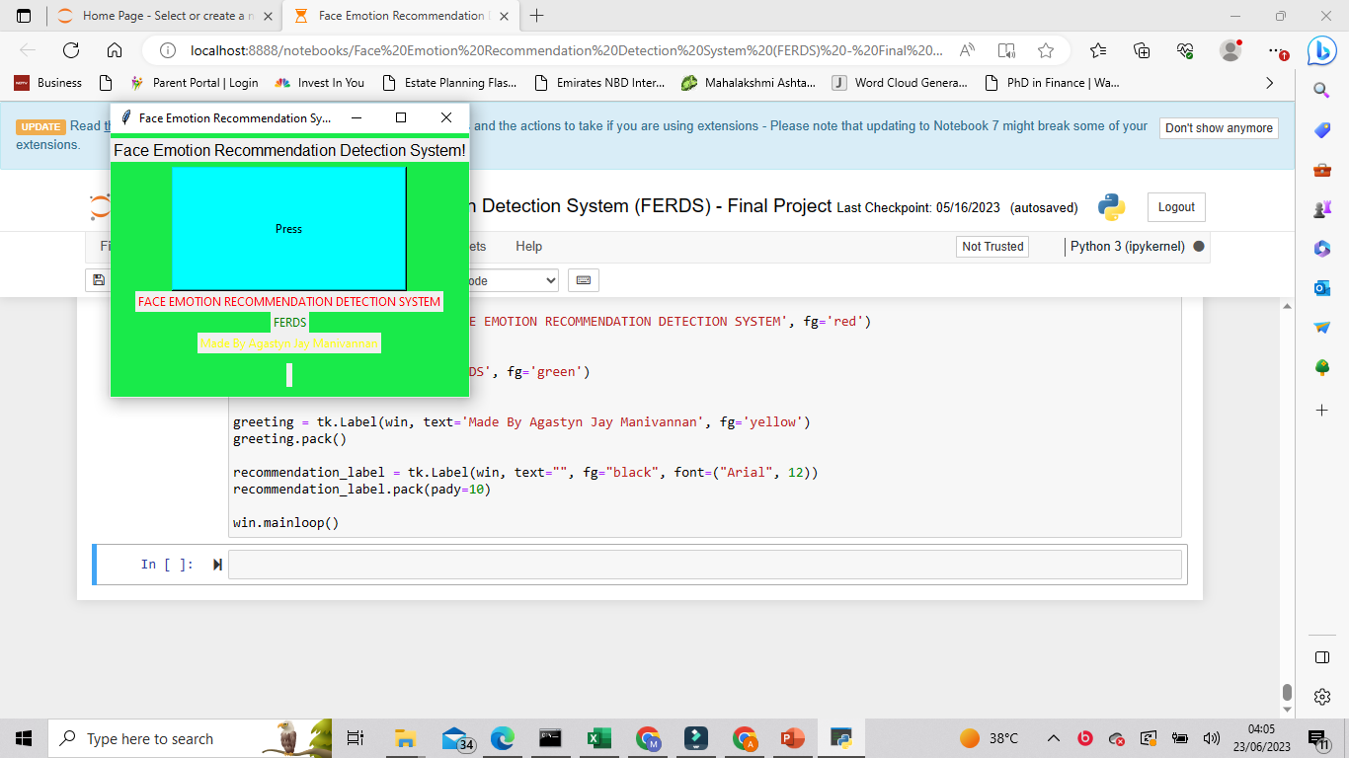
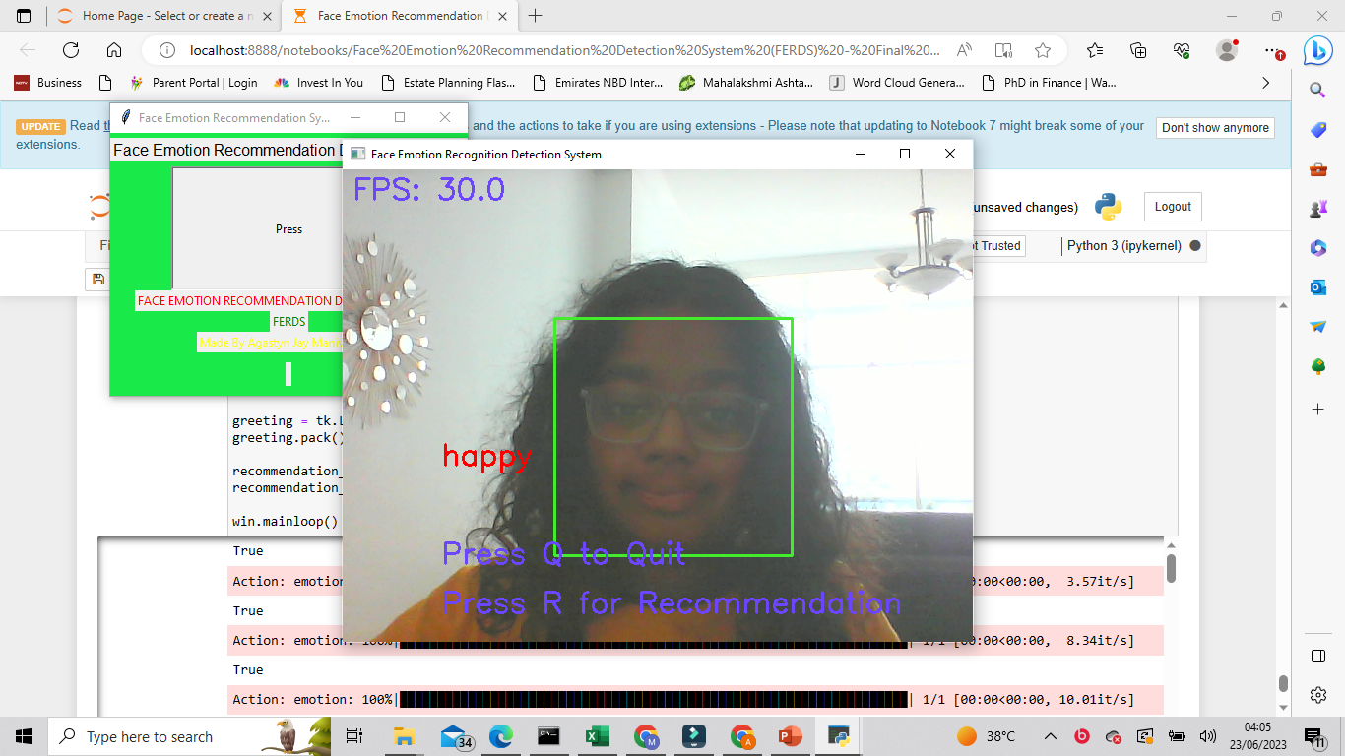
Steps of UI
1. Run the system and it will show the start page.
2. Click ‘Press’ and it will start running the live video feed, where it will show the emotion as well.

Slide 7
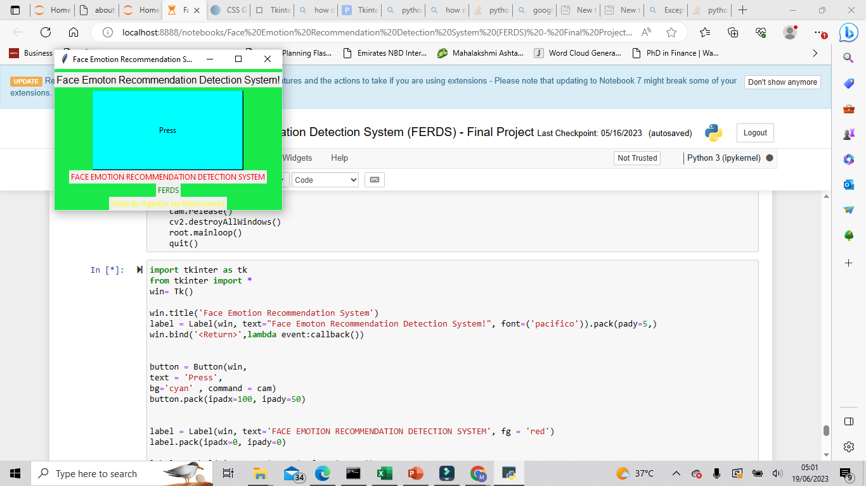
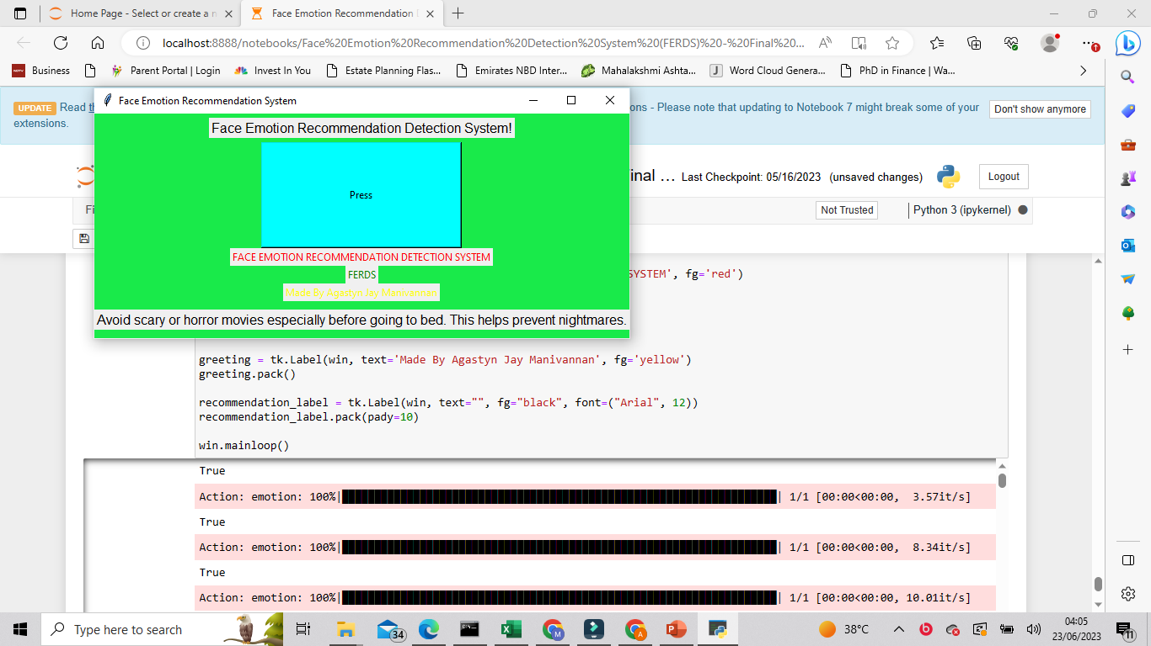
Steps of UI
3. If you press Q for quit, the video feed will break .
4. If you press R for recommendation, You will get your recommendation if you where happy, sad, etc…

Slide 8
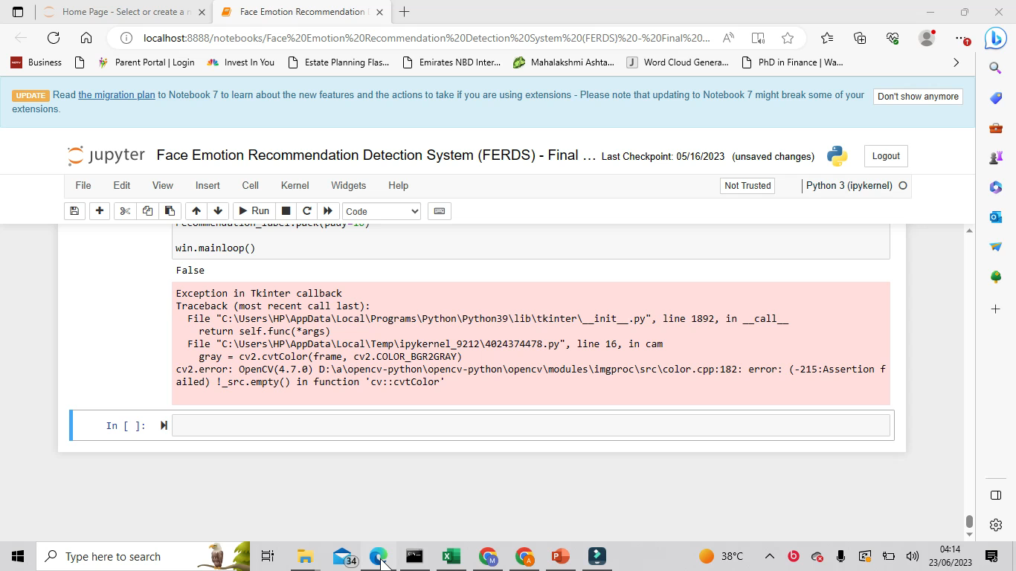
Demo video

Slide 9
Toolkit Walkthrough

Slide 10
Thank you
Agastyn Manivannan​
tjeya26@gmail.com

